Slide 1
A-TEAM
Shane, Jerome, Kannan and Siraj

Slide 2
Our Variables
Time Line : 2001 -2007
Variables:
Temperature
Population density
Target Variable: Energy Usage

Slide 3
Our Questions
What correlations can we draw between the changes in temperatures and energy consumption?
Looking at our graphs, which one of the two variables have the most impact on Energy consumption?
Do Temperature and Population variables affect energy consumption more together or independently?

Slide 4
ENERGY USAGE
Primary sources of energy in the US is fossil fuels
Data source we are:
catalog.data.gov
data.world
Observations
Scale had to be adjusted
Removed data that is too low or high so as to have a readable chart
Compared output with data in public forums
Domain knowledge is important. I was able to fix lot of data issues because of my general understanding of the field

Slide 5
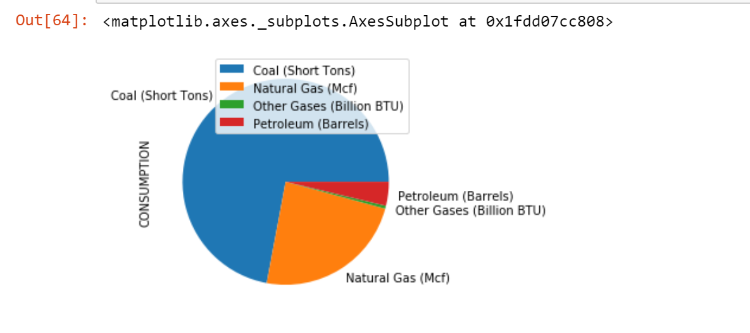
Fossil fuel type share

Slide 6
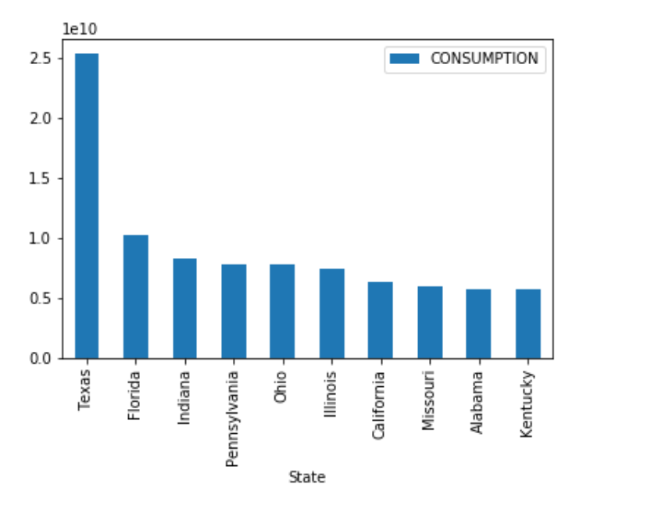
Largest Fossil Fuels consuming states

Slide 7
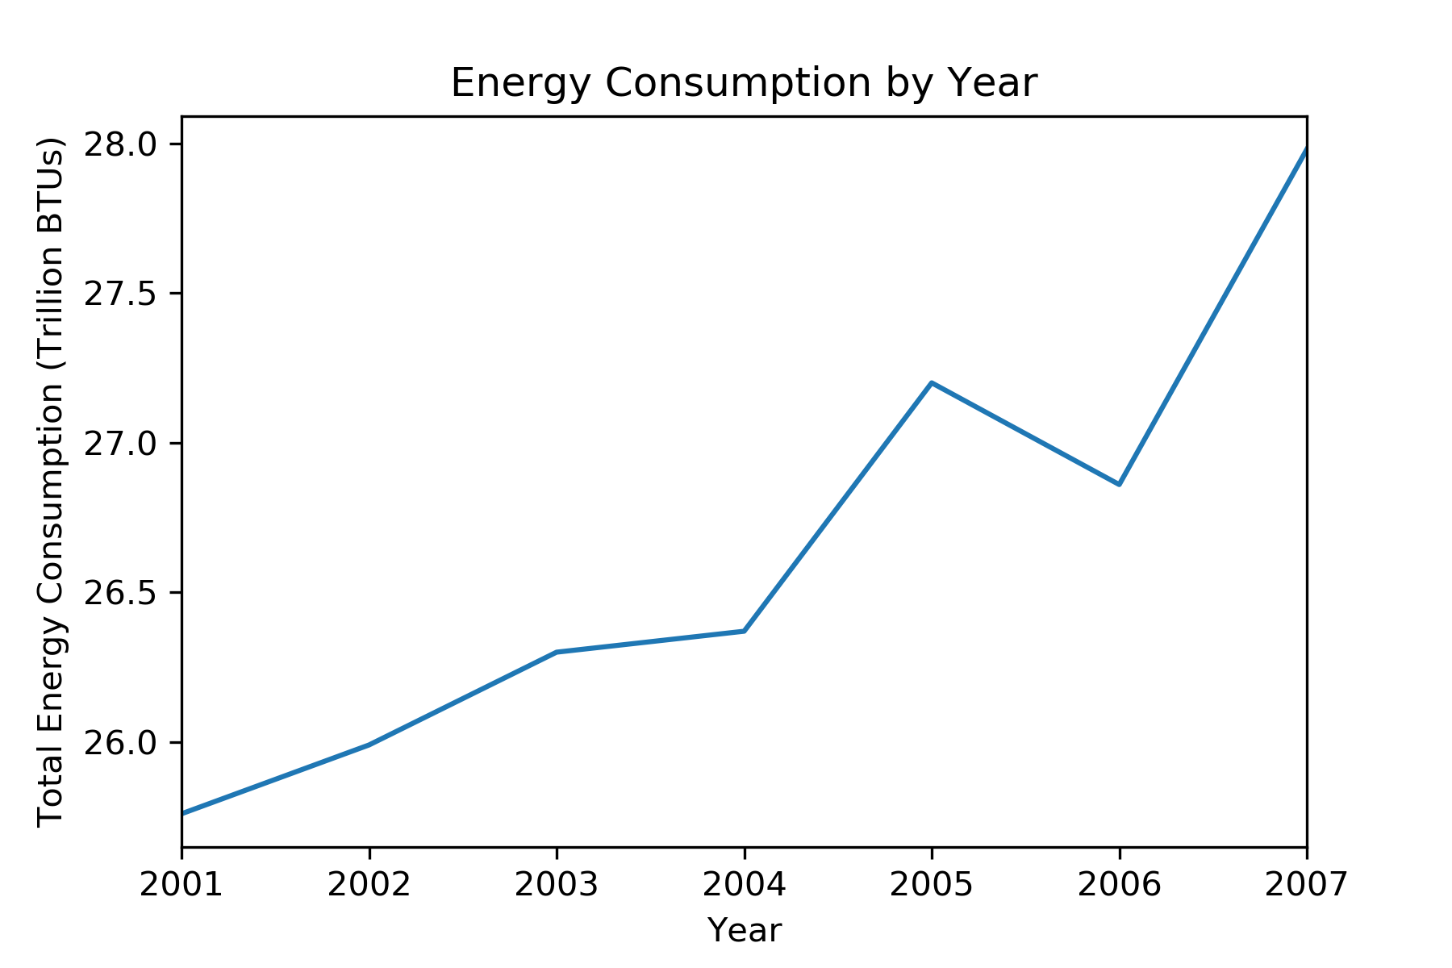

Slide 8
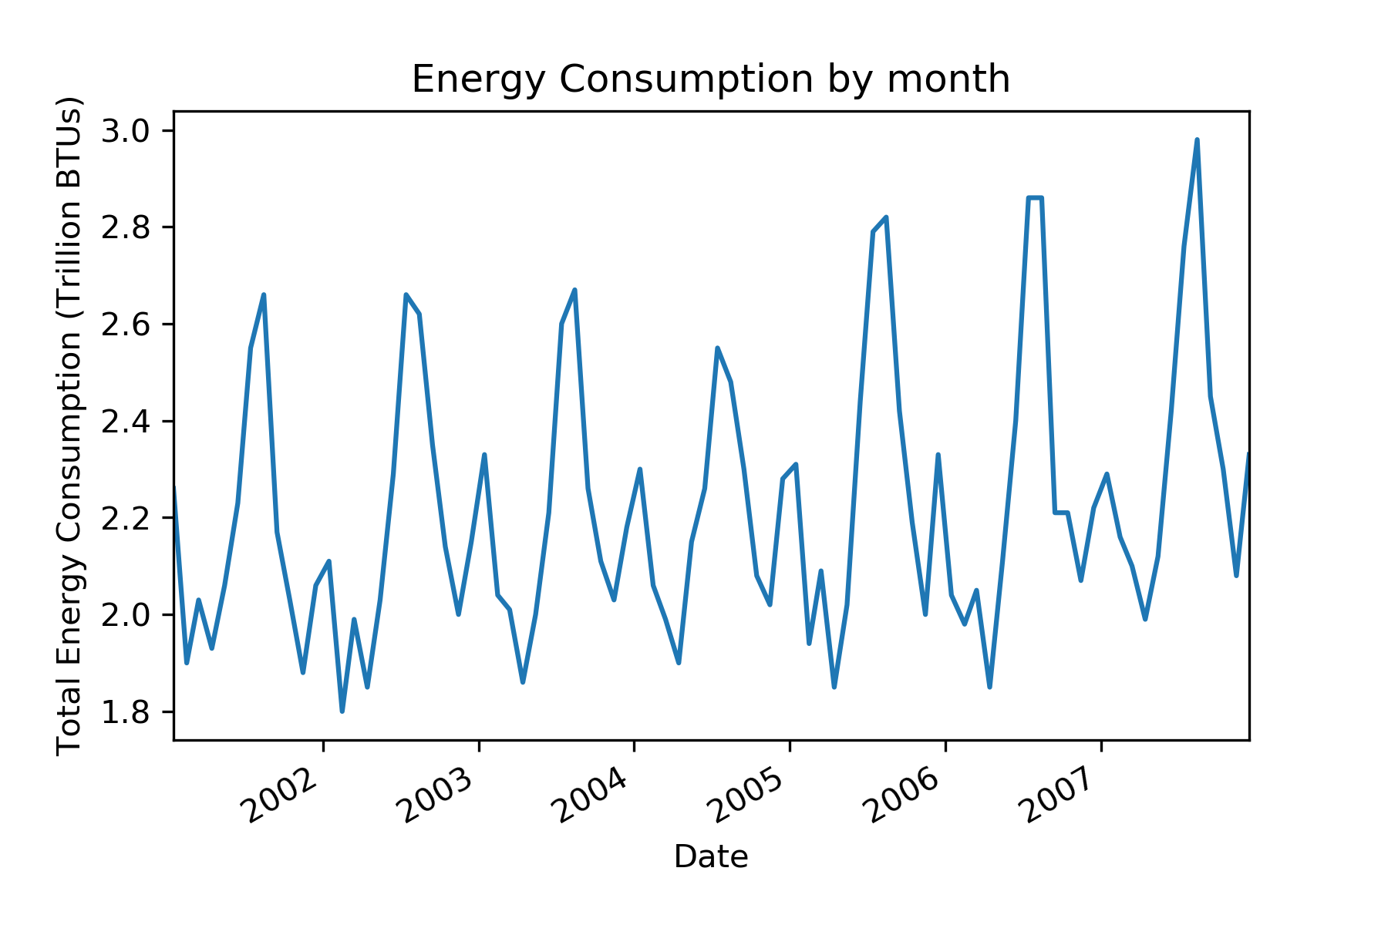

Slide 9
Analysis
Null: Energy consumption does not change over the 10 year period
Result: Energy usage has gone up in the time period

Slide 10
Population Density (Jerome)

Slide 11
Statistical Analysis
Null:
Result

Slide 12
Temperature FLUCTUATIONS (Shane)

Slide 13
Statistical Analysis
Null Hypothesis:
Result:

